Slide 1
Book Management System
by Naaz Bhagat & Karan Kumar Goyal

Slide 2

Contents
Introduction
Features
Project Overview
Tools & Technology
Architecture
Backend Design
Database Design
Front End Design
Conclusion
Future Scope
Acknowledgement

Slide 3
“Book Management System” is a user friendly web app to review books along with the details of their respective authors & stores.
“

Slide 4

Features!
Admin authentication
Book details including description, genre, author and store it’s available at.
Author details
Store details including owner contact and address

Slide 5
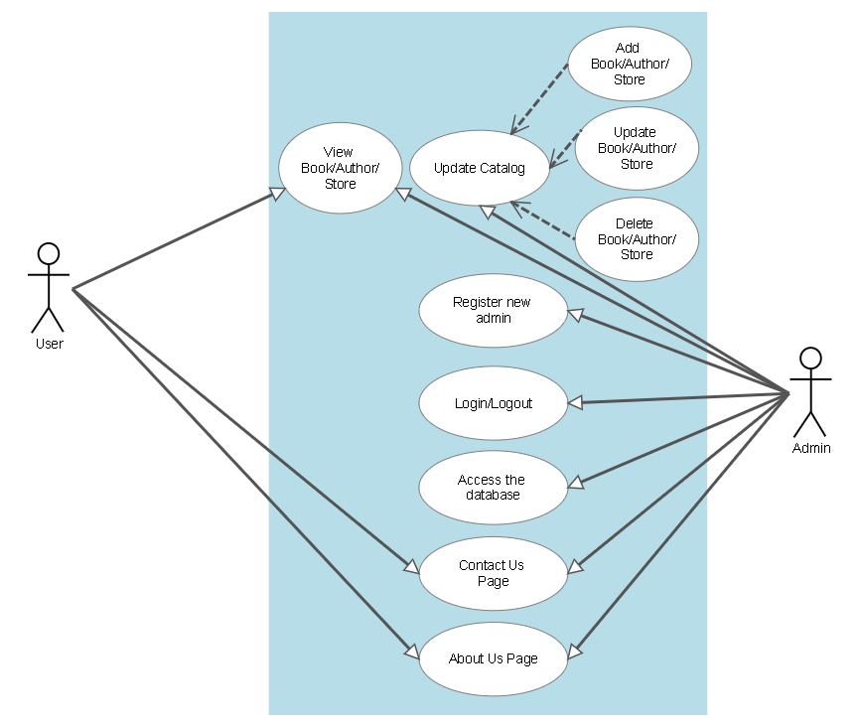
Project Overview

Slide 6





Tools & Technology

Slide 7
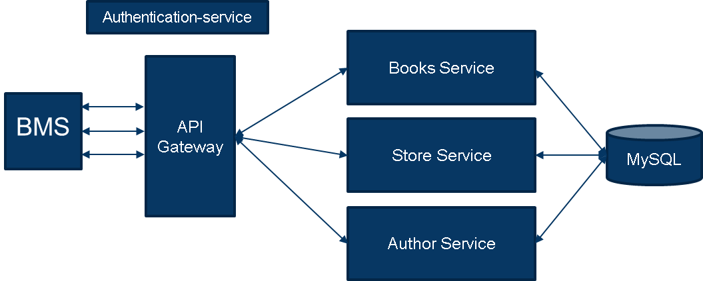
Architecture

Slide 8

BACKEND DESIGN
Code Snippets

Slide 9
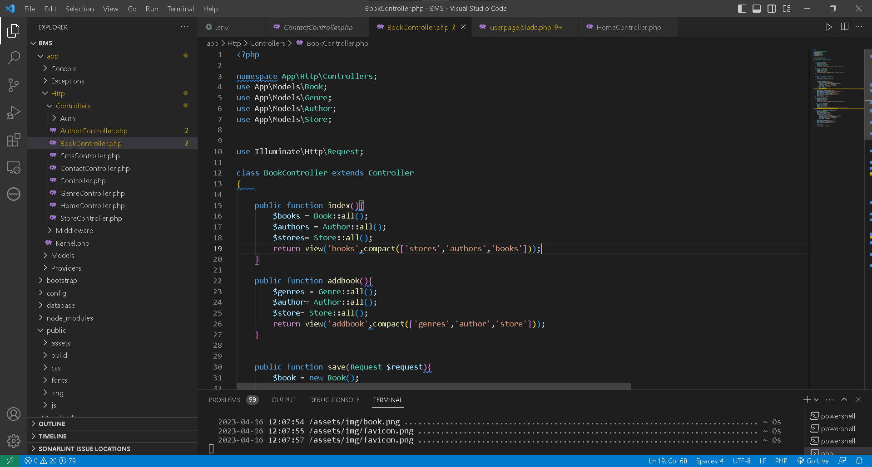
Books Controller

Slide 10
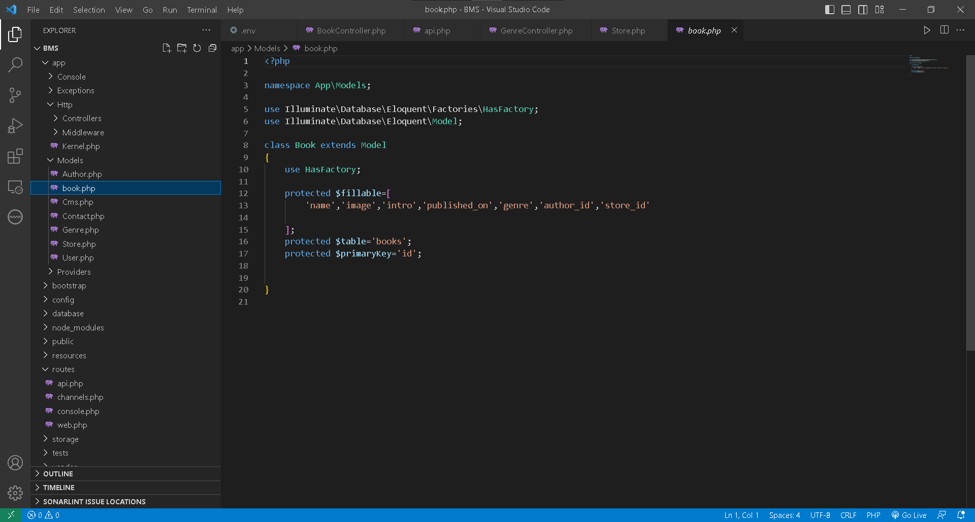
Book Model

Slide 11
DATABASE DESIGN
DB Snippets

Slide 12
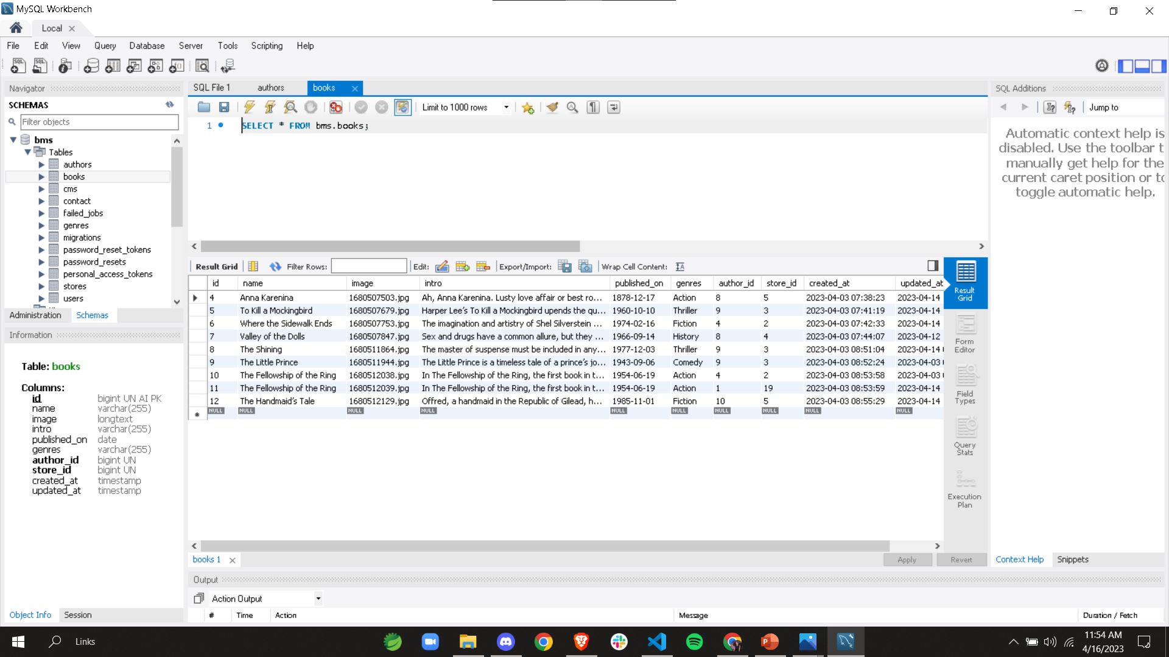
Books Table

Slide 13
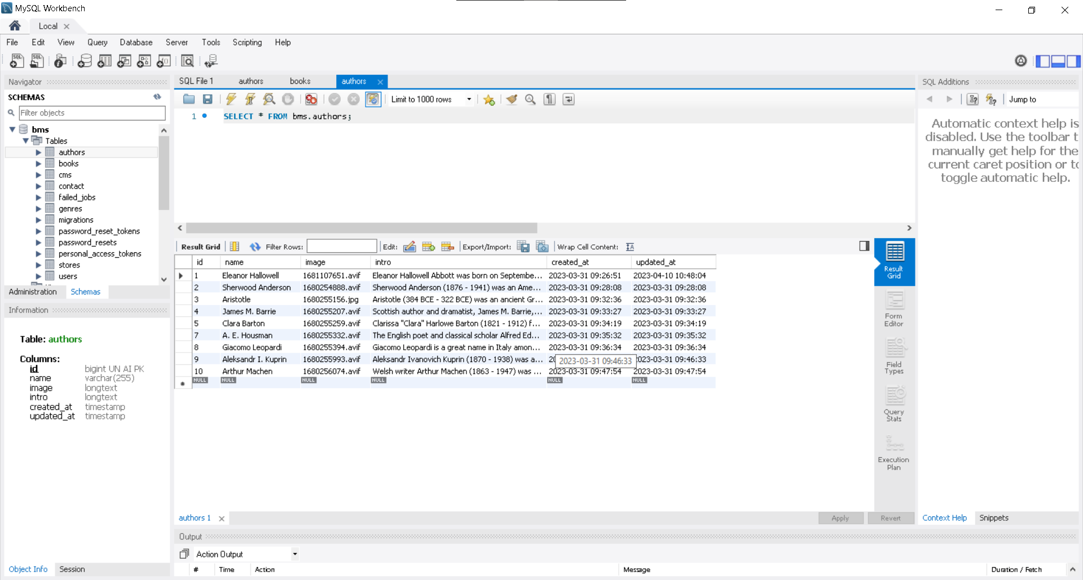
Authors Table

Slide 14
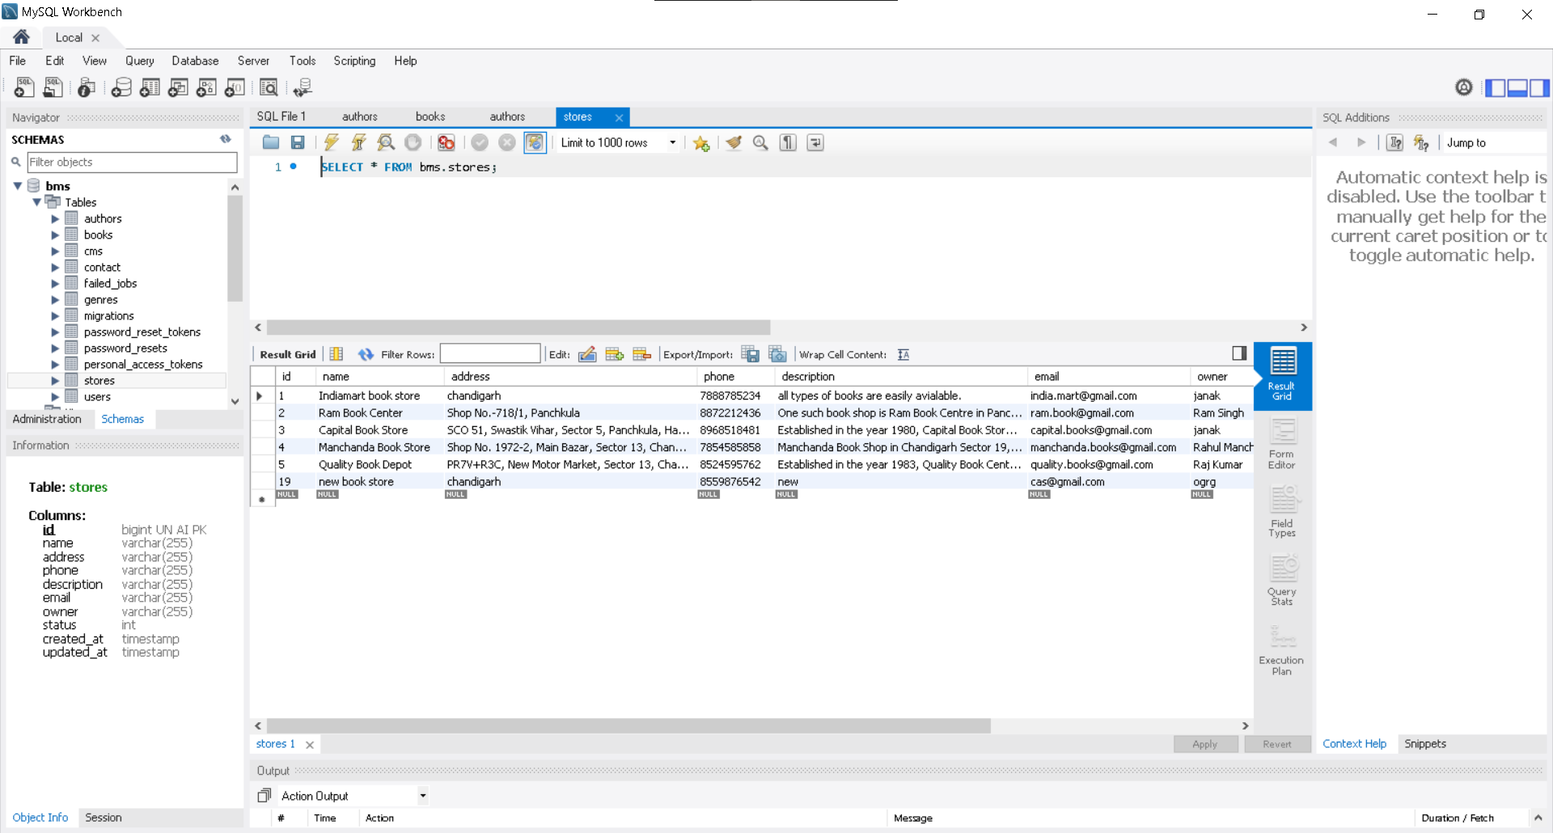
Stores Table

Slide 15
FRONT DESIGN
Code Snippets

Slide 16
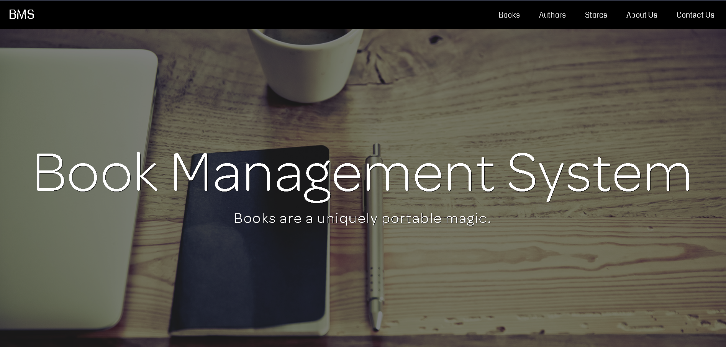
Home Page

Slide 17
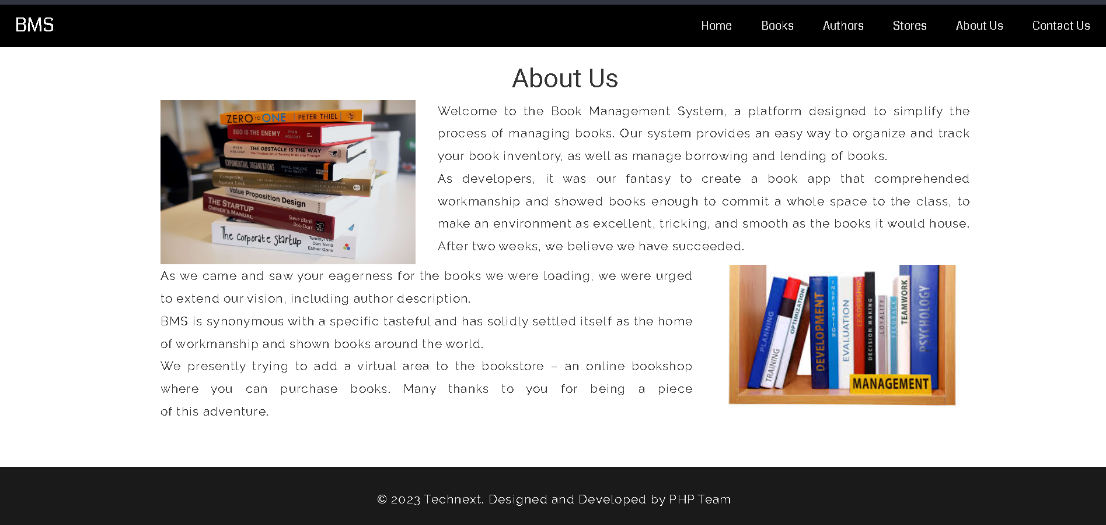
CMS - About US Page

Slide 18
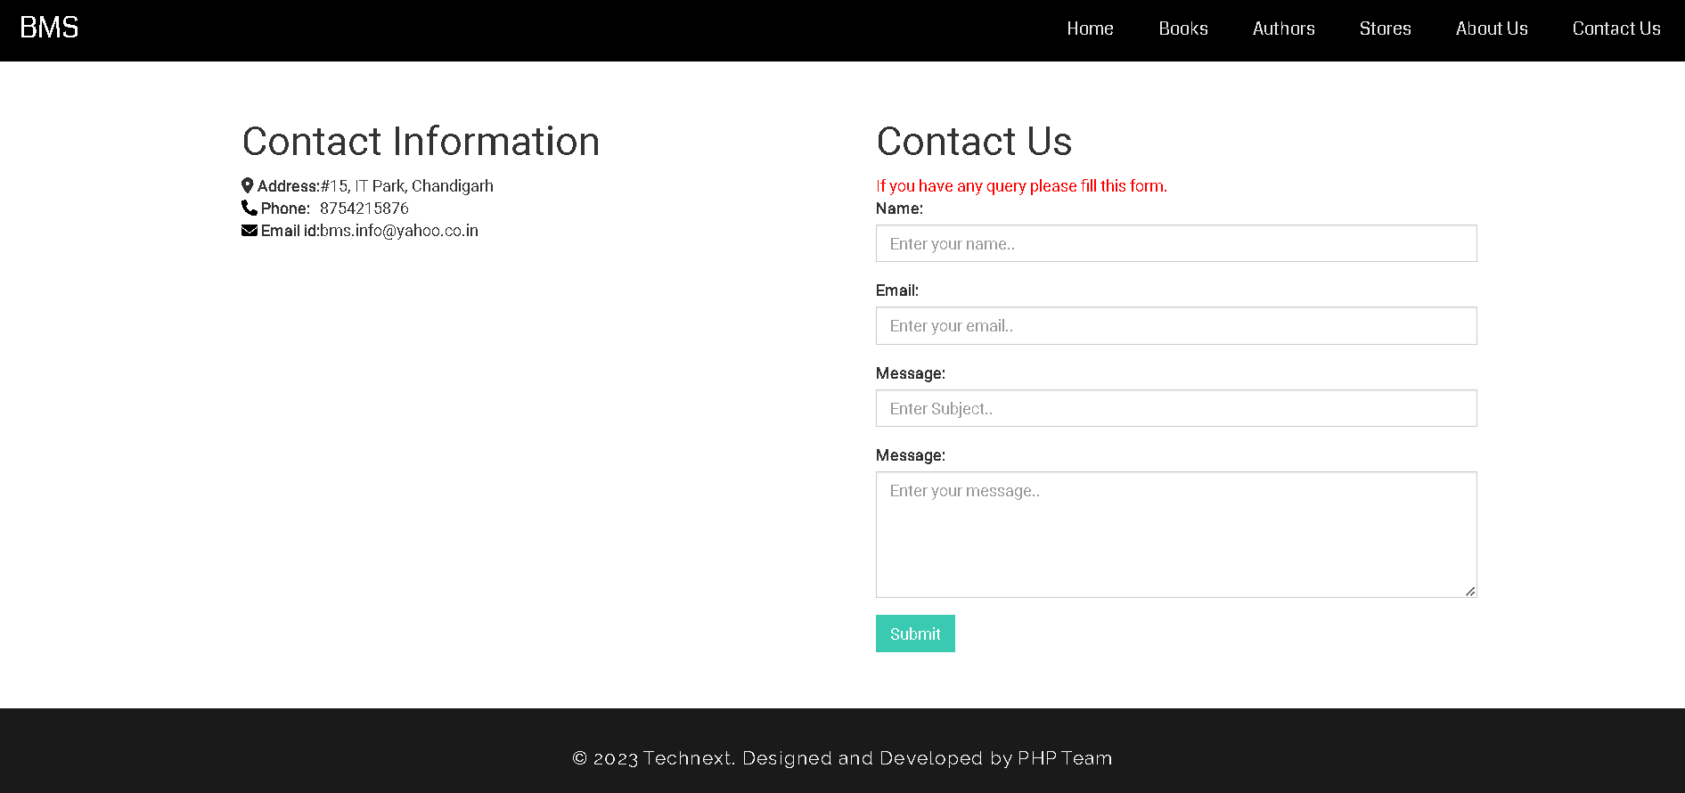
CMS - Contact Us Page

Slide 19
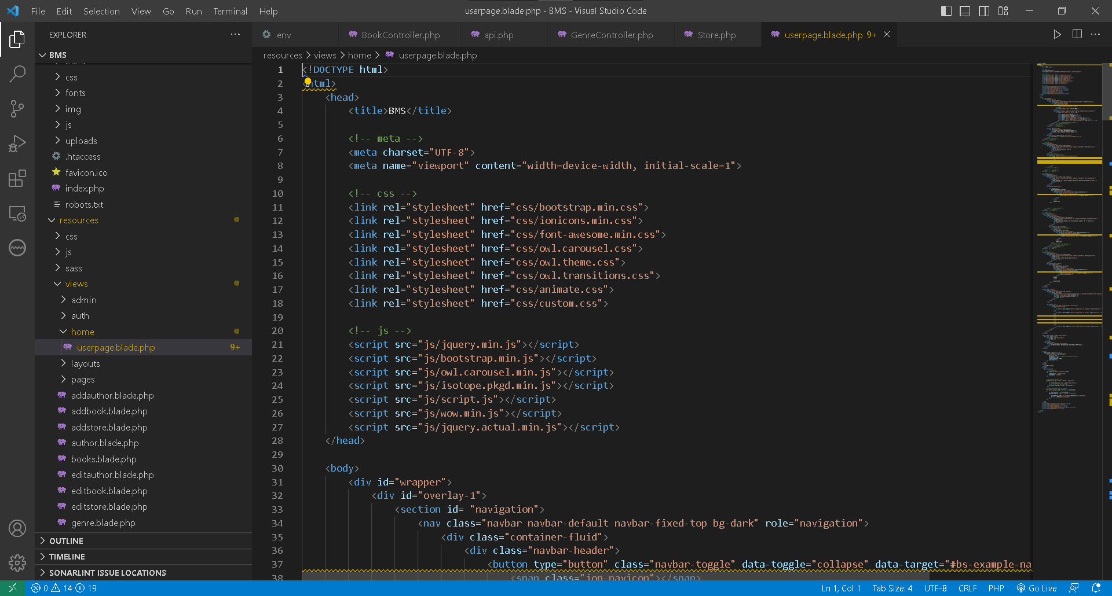
Userpage Blade File

Slide 20
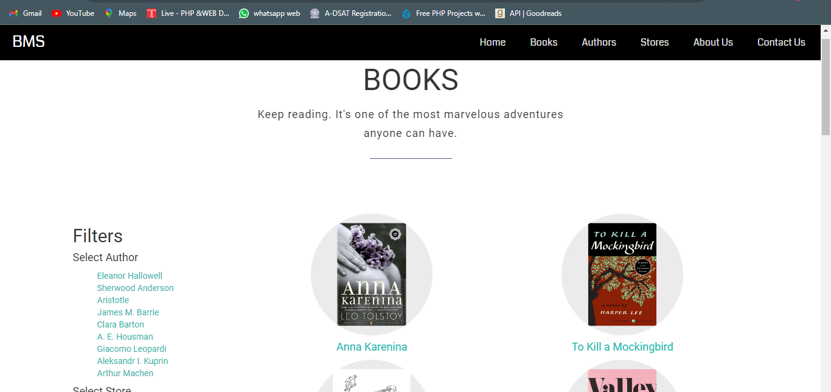
Books Listing

Slide 21
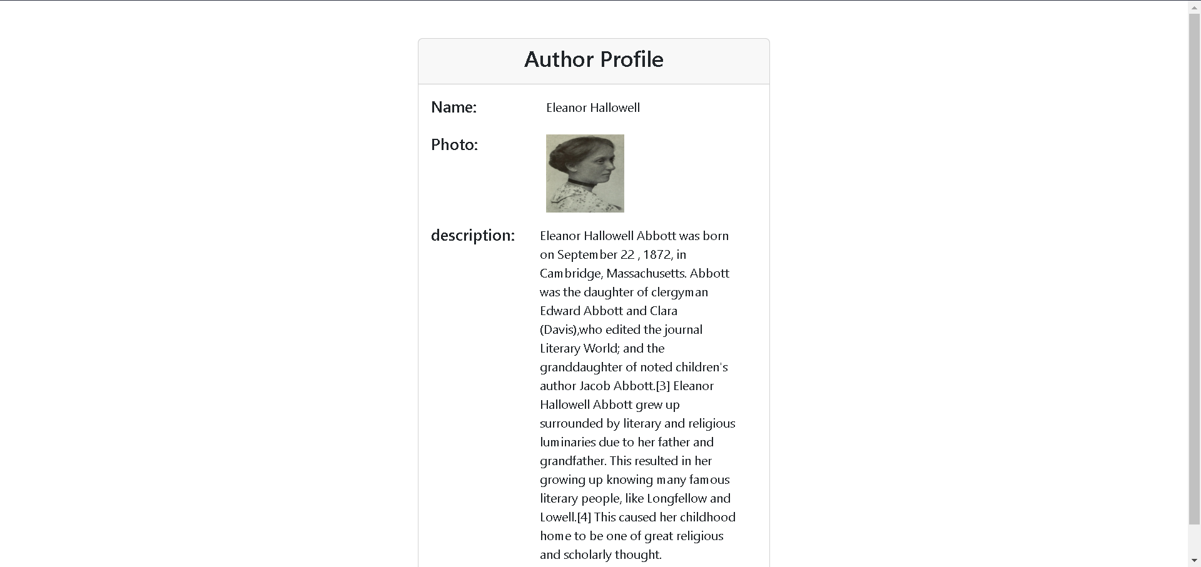
View Author Details

Slide 22
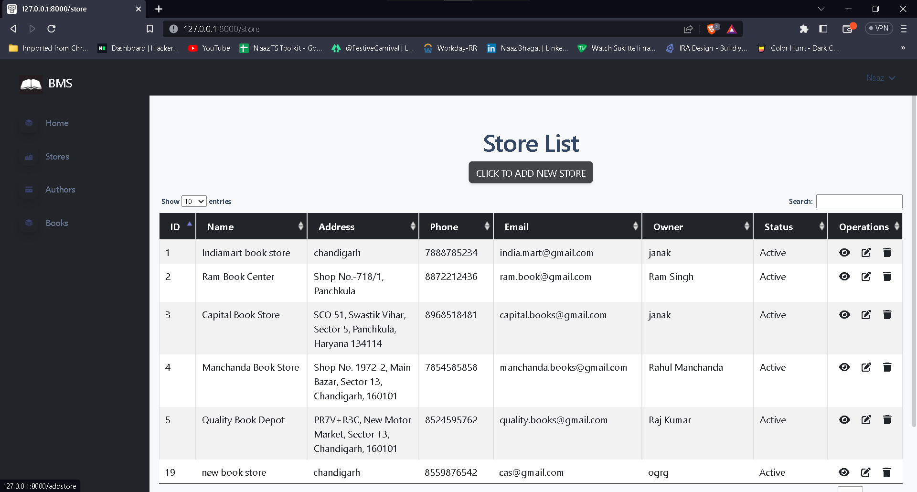
Store List

Slide 23
API TESTING
Postman Snippets

Slide 24
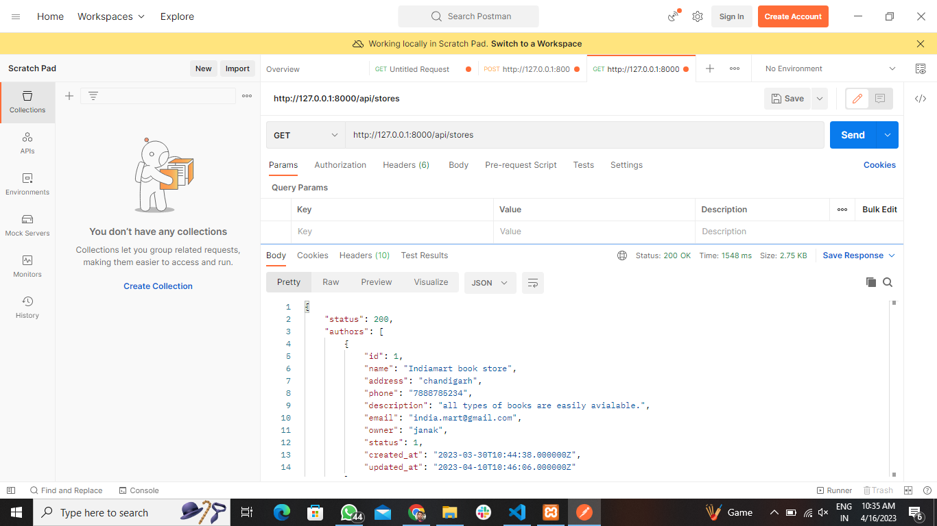
GET Method

Slide 25
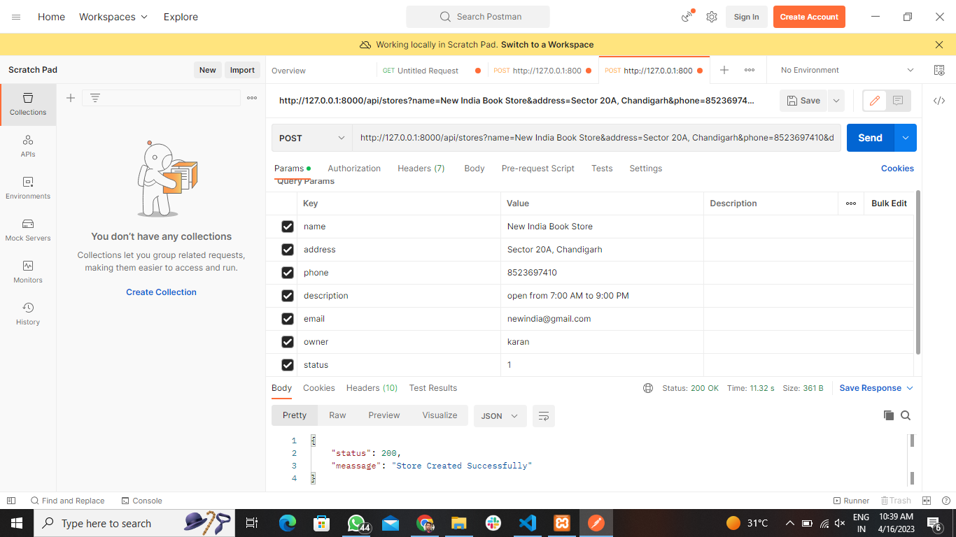
POST Method

Slide 26


ACKNOWLEDGEMENT
We are highly grateful to our mentors Ms Shikha and Mr Pankaj for stimulating guidance, continuous encouragement, and supervision throughout the course of present work. We would like to express a deep sense of gratitude and thanks profusely to Mr. Lalit and Mrs Anjali. Without the wise counsel and able guidance, it would have been impossible to complete the project in this manner. The help rendered by other PHP team members is greatly acknowledged.

Slide 27

FUTURE SCOPE
1.We will host the platform on online servers to make it accessible worldwide.
2.Book reading option can be added so that users can read the actual book content on our website.
3.More variety of books can be added.
4.Expand the categories with more options.
5.We can add a book store feature.

Slide 28

Conclusion
A simple and smart way of utilization of technologies like PHP, Html, CSS, JavaScript and all the mentioned technologies to make a responsive book management system which gives an easy access of the book details to the book lovers.

